Slide 1
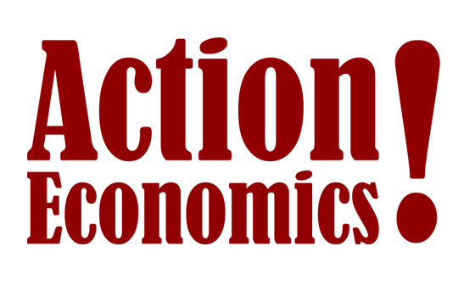
Trade, Trade Wars and Economic Impacts
Presented at the Keystone Policy Center and Global Interdependence Center Panel Discussion
September 20, 2018
Michael R. Englund
Principal Director and
Chief Economist,
Action Economics, LLC
www.actioneconomics.com
303-494-4228
mike.englund@actioneconomics.com

Slide 2
2
Tariffs Produce Price Distortions, Like all Taxes
Economists hate price distortions
Income tax, sales tax, quotas, tariffs are all distortions
We like “free trade agreements” because of the name!
Trade agreements just swap managed trade outcomes

Slide 3
3
Trump Hypothesis:
The U.S. underutilizes economic and military leverage in negotiations on trade and foreign policy because politicians are self-interested captured agents of lobbyists, and because the media rewards capitulation over confrontation.
Implication:
U.S. politicians avoid disruptive change, please lobbyists, and act civil. Reaching an agreement at any cost is “good statesmanship.”

Slide 4
4
Tariffs are a Negotiating Strategy, Not a Goal
Tariff threats are a “stick” to motivate adversaries
Threats must be credible to be effective
Analysis of “permanent tariffs” are just a benchmark
Macro forecasts need compromise assumptions

Slide 5
5
Average 2016 Tariff Rate, by Country/Area
Hong Kong/Macao 0%
Singapore 0.1%
Australia 1.2%
New Zealand 1.3%
Canada 1.6%
U.S. 1.7%
E.U. 2.0%
Japan 2.5%
China 3.5%
Russia 3.6%
Mexico 4.3%
India 6.3%
Brazil/Cuba 8.0%
Much of South America and Africa 7.0% or higher
* World Bank Estimates

Slide 6
6
U.S. Measures as % of Nominal GDP, 2017*
GDP (nominal) $19,485 bln 100%
GDP Export Component $2,350 bln 12%
GDP Import Component $2,929 bln 15%
GDP Net Export Component -$578 bln -3%
Imports of “Goods” $2,342 bln 12%
Imports of “Goods,” Pacific Basin $866 bln 4%
Imports of “Goods,” China $506 bln 3%
* U.S. BEA, Census Bureau

Slide 7
7
U.S. Tariffs were Still Small as of August 2018
U.S. Customs Receipts were $35 bln in 2017.
Tax Foundation: $22 bln new annual tariff revenue
Each $40 bln tariff revenue ~ -0.1% GDP, -90k jobs
Supply chain disruptions might be big
2018 Tax Cut ~ $150-$175 bln per year on average
U.S. federal government FY18 revenue = $3,338 bln

Slide 8
8
U.S. China Tariffs Escalate on Sep-24 and at Year-End
A 10% tariff on another $200 bln on September 24
New tariff revenue then at a $42 bln annual rate
Tariff rate hiked to 25% in 2019
New tariff revenue then at $72 bln annual rate
Impact: -0.2% for GDP in one year, -162k payrolls

Slide 9
9
Economic Adjustment will Mitigate Tariff Damage
25% tariff on $250 bln Chinese goods = $63 bln?
Cumulative “all China” new 25% tariffs = $139 bln?
Many traded commodities are fungible
Bilateral goods substitution could be substantial
China can reduce bilateral gap at any time

Slide 10
10
The Tautology:
Current Account Deficit = Capital Account Surplus
Offsetting entries with trade accounting
If savings < investment, then net capital inflows
Static total capital account = static total current account
FX rates move to equate supply and demand
A higher U.S. tariff means a higher U.S. dollar

Slide 11
11
Implications of Trade Negotiations
Tariffs will end up higher for some goods
The dollar will end up stronger
China will substitute imports for fungible goods
Big bilateral deficits will be shifted to other countries
Little aggregate trade deficit effect is likely
Successful policy means stronger GDP, bigger deficits

Slide 12
12
Policy Induced U.S. Real GDP Forecast Adjustments
Real Q4/Q4 GDP Growth 2018 2019 2020
Pre-Tax and Fiscal Stimulus 2.5% 2.4% 2.2%
Post-Stimulus 3.2% 2.8% 2.4%
Tariffs as Threat (Sept. estimates) 3.2% 2.7% 2.4%
Permanent China Tariffs 3.2% 2.5% 2.2%
U.S. Net Exports (Sept. estimates) -$888b -$940b -$977b
Stimulus Size Estimates (in $bln):
December 2017 Tax Cuts $206 $275 $250
March 2018 Fiscal Stimulus $70 $85 $85
September New Tariff Levels -$21 -$62 -$62
“All-China” Tariff Starting in 2019 -$21 -$116 -$116
Total $234 $182 $157

